Slide 1
Maryland General Service, Inc. Area 29 District 18 Workshop “Service: Sobriety in Action” Why Is Service Important?
Saturday, August 28, 2021
Presented by Don B.
Panel 68 Area 29 Past Delegate
Notes:
I’m a grateful alcoholic named Don B. I have been privileged to serve in 2018 and 2019 as your Maryland Area 29 Panel 68 Delegate to the General Service Conference . . .

Slide 2
Panel 68 Area 29 Past Delegate
President of Maryland General Service, Inc.
CARC-1 Mentor
Notes:
. . . as the current President of your Maryland General Service Board of Directors, and as the Mentor for the Conference Agenda Review Committee for the Eastern Shore.

Slide 3
Maryland General Service, Inc. Area 29 Special Assembly Why Is Service Important? and Our Biennial Area 29 Election
Monday, August 16, 2021
Presented by Don B.
Panel 68 Area 29 Past Delegate
Notes:
I’ll be sharing with you for the next ten minutes about the importance of service in Alcoholics Anonymous and, more specifically, about our Election Assembly in October, when we will elect our Area 29 service leaders for the next two years.

Slide 4
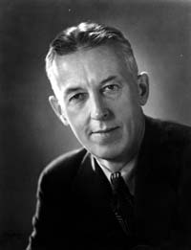
“Good service leaders, together with sound and appropriate methods of choosing them, are at all levels indispensable for our future functioning and safety. . .”
Notes:
In his essay on Concept IX in Twelve Concepts for World Service, A.A. co-founder Bill W. states, in part, that “Good service leaders, together with sound and appropriate methods of choosing them, are at all levels indispensable for our future functioning and safety. . .

Slide 5
“. . . We must continually find the right people for our many service tasks. . .”
Notes:
“. . . We must continually find the right people for our many service tasks. . . “

Slide 6
“. . . As the GSRs meet in their Assemblies to name Delegates, an even greater degree of care and dedication will be required. . .”
Notes:
“. . . As the GSRs meet in their Assemblies to name Delegates, an even greater degree of care and dedication will be required. . . “

Slide 7
“. . . Who are the best qualified people that we can name? This should be the thought of all.”
Notes:
“. . . Who are the best qualified people that we can name? This should be the thought of all.”

Slide 8
Biennial Area 29 Election Assembly
Saturday, October 16, 2021
9:00 am to 3:00 pm
Notes:
Our Biennial Area 29 Election Assembly is scheduled for October 16, 2021.

Slide 9
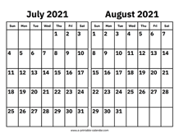
Notes:
During previous years, our Past Delegates have led workshops and training sessions at the July Area Committee meeting and the August Area Assembly meeting to emphasize the importance of preparing for and participating in the elections.

Slide 10
Notes:
Since neither of those meetings were on the Area 29 calendar this year, your Board of Directors voted at our March annual meeting to utilize the reconvening of the CARCs this summer to accomplish that goal.

Slide 11
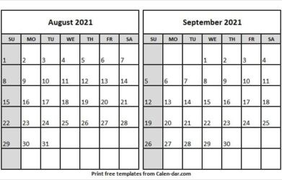
Area 29 2021 Election Preparation Training
Notes:
Our Area Chair also graciously carved out time on the agendas of the Area 29 Special Assembly on August 16 and during the Area Committee meeting on Saturday, September 18 to help us prepare for our Biennial Election Assembly in October.

Slide 12
Area 29 2021 Election Preparation Training
Notes:
The August 16 Special Assembly, however, ran more than an hour longer than planned, so the Biennial Election Assembly presentations were not held and are likely to be delayed until the Area Committee Meeting on September 18, only four weeks before the Election Assembly on October 16.

Slide 13
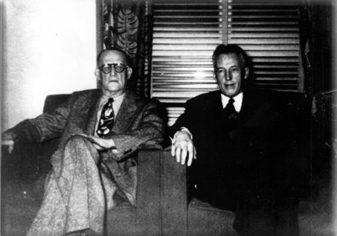
Notes:
I am not here to discuss the actual election process. That will be thoroughly explained on the day of the election. Today, I want to stress the importance of service in A.A. and the critical need to elect capable individuals to serve Area 29. Our future effectiveness calls for willing, available, and qualified members to stand for the service leadership positions which will be elected on October 16. So, let’s take a look at why Area 29 was originally created, and then consider how that original purpose has evolved over the years into something even more vital for the A.A. of tomorrow.

Slide 14
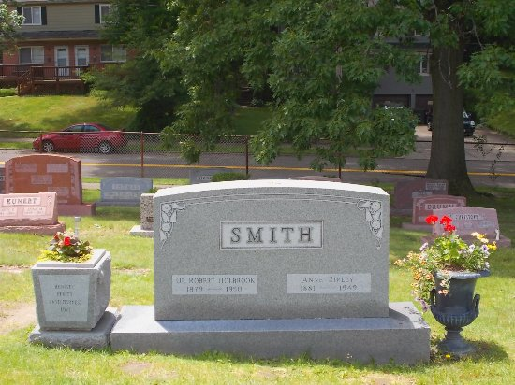
Notes:
In the late 1940’s, when A.A. co-founder Dr. Bob S. was diagnosed with cancer, it became absolutely clear that Bill and Bob would not be around forever. The future leadership of A.A. was in peril.

Slide 15
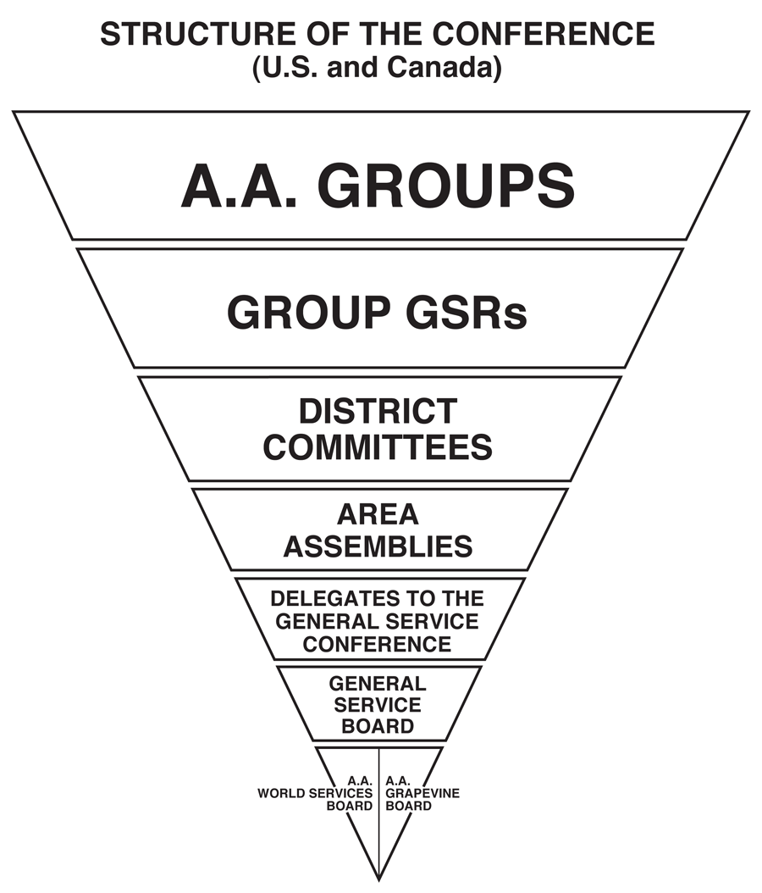
Notes:
Bill proposed a plan for an elected annual conference to which the Board of Trustees of Alcoholics Anonymous could eventually become accountable. All groups in the U.S. and Canada (now represented by General Service Representatives, or GSRs) were asked to assemble into districts to elect what we now call our District Committee Members, or DCMs. Geographical groups of DCMs were combined to form a larger “area” to elect a Delegate from among their ranks to attend the General Service Conference, which began as a five-year experiment in 1950 and was reaffirmed as the permanent successor to our co-founders in 1955.

Slide 16
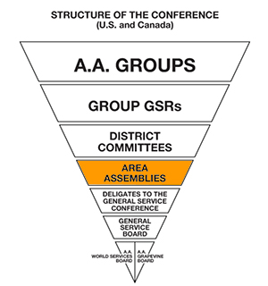
MGS Committees:
Accessibilities
Archives
Audio
CARCs
C.P.C.
Corrections
Finance
Grapevine
Host
Intergroup Liaison
Literature
Margenser
Mini-Conference
Parliamentarian
Policy & Procedure
Public Information
Registrar
State Convention
Technology
Treatment
Webmaster
Workshop
Notes:
Electing a delegate to represent us at the annual General Service Conference remains the most important responsibility of any area, but the areas and districts in the U.S. and Canada have continued to evolve and currently perform a variety of other services for the A.A. Fellowship. Area 29, now incorporated as Maryland General Service, Inc., would not be able to function without dozens of other qualified area service leaders.

Slide 17
MGS Committees:
Accessibilities
Archives
Audio
CARCs
C.P.C.
Corrections
Finance
Grapevine
Host
Intergroup Liaison
Literature
Margenser
Mini-Conference
Parliamentarian
Policy & Procedure
Public Information
Registrar
State Convention
Technology
Treatment
Webmaster
Workshop
Biennial Area 29 Election
October 16, 2021
to elect our
Panel 72, Area 29
Officers:
Delegate
Alternate Delegate
Area Chairperson
Area Secretary
Area Treasurer
Term of service is
January 1, 2022
through
December 31, 2023
Notes:
On October 16, a total of five officers will be chosen to lead Area 29 in service for the next two years. We will elect our Panel 72 Area 29 Delegate, Alternate Delegate, Area Chairperson, Area Secretary, and Area Treasurer to serve us in 2022 and 2023.

Slide 18
Voting Members of the Area 29 Assembly:
General Service Representatives
Alternate GSRs, when the GSR is not present
District Committee Members
Alternate DCMs, if DCM is not present
Area Service Committee Chairs
Co-Chairs, if Committee Chair is not present
Area Officers
Past Delegates do not vote unless they serve
in a voting position such as Committee Chair
Notes:
Ideally, all GSRs, DCMs, Service Committee leaders and interested A.A. members should attend every Area assembly held in any given year. These assemblies provide information to our groups about the health of A.A. worldwide and introduce new tools to help us carry the message to other alcoholics. Attendance at area meetings and events provides everyone an opportunity to meet the trusted servants who serve the area and to watch them in action. This permits us to make a well-informed decision every two years when our next area election assembly takes place.

Slide 19
“Our real purpose
is . . .
service . . .”
Notes:
As our Big Book reminds us on page 77, “Our real purpose is to fit ourselves to be of maximum service to God and the people about us.” Whether we perform service at our home group, intergroup, district, or area, our personal recovery is enhanced by the experience. I could talk all night about how much I have enjoyed service in A.A., the many ways that service has helped me to grow, and the lifelong friendships I have made in the process. Attending area assemblies or events and serving on area service committees is an opportunity for you to consider what your next service job might be. Every one of us grows from the experience of service.

Slide 20
“Maybe you should stand and leave the choice to God.”
Notes:
Yet I was very reluctant to stand for area office back in 2013. I had plenty of excuses, from thinking I was not qualified, to saying I needed more experience in area committee service, to having my heart set on a particular service position. It was only after three trusted servants urged me to consider standing for Area Secretary that I finally consented to stand for the position. I had no argument left when one of them suggested, “Maybe you should stand and leave the choice to God.” Only four years later I watched my name being drawn from the hat as the next Area 29 Delegate.

Slide 21
MGS Committees:
Accessibilities
Archives
Audio
CARCs
C.P.C.
Corrections
Finance
Grapevine
Host
Intergroup Liaison
Literature
Margenser
Mini-Conference
Parliamentarian
Policy & Procedure
Public Information
Registrar
State Convention
Technology
Treatment
Webmaster
Workshop
Biennial Area 29 Election
October 16, 2021
to elect our
Panel 72, Area 29
Officers:
Delegate
Alternate Delegate
Area Chairperson
Area Secretary
Area Treasurer
Term of service is
January 1, 2022
through
December 31, 2023
Notes:
During the process of moving down our inverted service triangle, I have observed that the trusted servants of my district, intergroup, and area have invested a whole lot of time in training me and providing me with ever-increasing opportunities for my spiritual development. And the more I experience, the more I realize there is yet to learn, so I have developed a passion to study and to grow in knowledge and effectiveness. It becomes increasingly clear that, in order for A.A. to function well and provide the best possible service to the alcoholic who still suffers, our area needs servants willing to step up and take an active role—which is precisely what I have made an effort to do, what every current and former area trusted servant has done, and what you can do, too.

Slide 22
Maryland General Service Area 29 Assembly Handbook
Election of Area 29 Officers
Timing of the Elections
The election of all Area Officers is held in October of the odd-numbered years.
Eligibility for Nomination
Delegate—All current and past Area 29 Maryland General Service Area Committee Members, excluding current and past Delegates.
Alternate Delegate—All current and past Area 29 Maryland General Service Area Committee Members.
Chairperson, Secretary, Treasurer—All current and past Area 29 Maryland General Service Area Committee Members, and all DCMs-elect.
Prior to the closing of nominations for each of the above positions, the Assembly is asked if it wishes to open the nominations to any other individual member of A.A. If approved by a simple majority, additional nominations are then accepted, when seconded. All nominees must be present at the time of voting to be eligible for election to any position.
Voting Procedure
Third Legacy procedure, as described on pages S21 and S22 of the 2018-2020 A.A. Service Manual, and illustrated on the following page, is used to elect each of the above trusted servants. Election Procedure Delegate / Alternate Delegate, Chairperson, Secretary, Treasurer— The most recent past Delegate will conduct the election. Other past delegates attending the October election assembly will be responsible for the tallying of ballots. Eligibility to Vote The following trusted servants are eligible
Election Procedure
Delegate / Alternate Delegate, Chairperson, Secretary, Treasurer— The most recent past Delegate will conduct the election. Other past delegates attending the October election assembly will be responsible for the tallying of ballots. Eligibility to Vote The following trusted servants are eligible to vote: Area Officers – Delegate, Alternate Delegate, Chairperson, Secretary, Treasurer GSRs (or their alternates), DCMs (or their alternates), Chairpersons of Area Service Committees (or their Co-Chairs)
Notes:
I encourage each of you who is eligible to serve, to take a few minutes to review the qualifications and responsibilities of each officer position in The A.A. Service Manual and in the Maryland General Service Area Assembly Handbook found on the marylandaa.org website. If you have served on the Area Committee, either as a DCM or an Area Service Committee Chair, or you have been elected as a new DCM, you meet the qualifications to serve as an area officer. Speak to your service sponsor or a past officer to learn from their experience, and just be willing to make yourself available.

Slide 23
Biennial Area 29 Election
October 16, 2021
to elect our
Panel 72, Area 29
Officers:
Delegate
Alternate Delegate
Area Chairperson
Area Secretary
Area Treasurer
Term of service is
January 1, 2022
through
December 31, 2023
Notes:
On Saturday, October 16, 2021, either online or at Severna Park United Methodist Church, mindful of Covid safety concerns, each voting member of the area will have the opportunity to elect the trusted servants who will serve the groups in Area 29 as Delegate, Alternate Delegate, Area Chairperson, Area Secretary, and Area Treasurer for the next two-year term beginning on January 1, 2022. We will hold a Third Legacy Procedure election on October 16 which will take a full day beginning at 9:00 am and ending at 3:00 pm. This is an experience found nowhere else on earth besides A.A., and is one that you will not want to miss.

Slide 24
AREA 29 OFFICER ELECTION – A.A. SERVICE RESUME SHEET
This optional service resume sheet was approved by the Area 29 Assembly in 2015 and has been revised in 2021 by the MGS, Inc. Board of Directors. Completed resumes from people who stand for officer positions will be shared with the voting members attending the Panel 72 Area 29 Election Assembly on October 16, 2021. Members who think they may stand are encouraged to submit a completed service resume to boardpresident@marylandaa.org no later than 12:00 noon on Friday, October 15, 2021. Please send any questions you may have to that e-mail address.
NAME: SOBRIETY DATE:
HOME GROUP: DISTRICT: AREA:
A.A. SERVICE BACKGROUND
(Please specify experience in A.A. service.)
CURRENT A.A. SERVICE ACTIVITIES
RELEVANT OCCUPATIONAL AND/OR EDUCATIONAL BACKGROUND (OPTIONAL)
Notes:
A service resume template with instructions is now available for those who wish to submit one. Resumes are encouraged, but not required in order to stand for a position. The resume template might appear intimidating at first look, but remember that it is nothing more than a one-page listing of your experiences in A.A. and in your life.

Slide 25
AREA 29 OFFICER ELECTION – A.A. SERVICE RESUME SHEET
This optional service resume sheet was approved by the Area 29 Assembly in 2015 and has been revised in 2021 by the MGS, Inc. Board of Directors. Completed resumes from people who stand for officer positions will be shared online with the voting members attending the Panel 72 Area 29 Election Assembly on October 16, 2021. Members who think they may stand are encouraged to submit a completed service resume to boardpresident@marylandaa.org no later than 12:00 noon on Friday, October 15, 2021. Please send any questions you may have to that e-mail address.
NAME: SOBRIETY DATE:
HOME GROUP: DISTRICT: AREA:
A.A. SERVICE BACKGROUND
(Please specify experience in A.A. service.)
CURRENT A.A. SERVICE ACTIVITIES
RELEVANT OCCUPATIONAL AND/OR EDUCATIONAL BACKGROUND (OPTIONAL)
It might surprise you to discover just how qualified and prepared you are to move down the service triangle! All it takes is the willingness to make yourself available.
Notes:
It might surprise you to discover just how qualified and prepared you are to move down the service triangle! All it takes is the willingness to make yourself available.

Slide 26
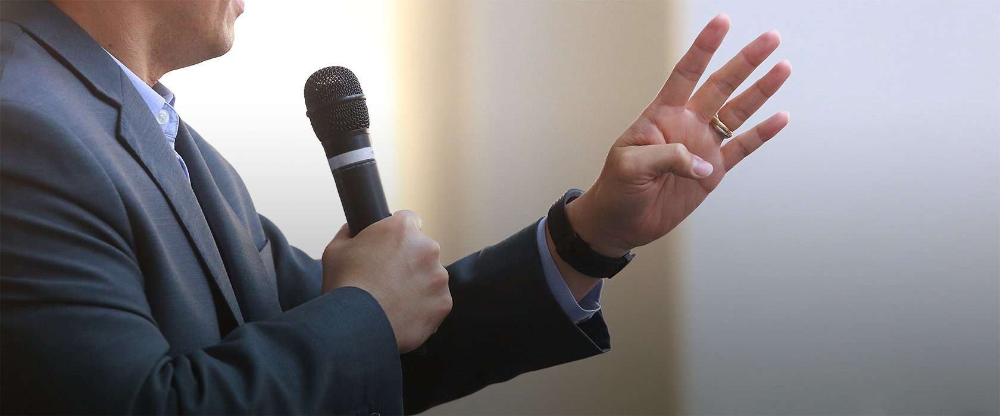
Submit completed resumes electronically to boardpresident@marylandaa.org
Deadline: 12:00 noon on Friday, October 15
If the election is held in person, the resumes will be handed out to voting members for review just prior to each election. If we conduct the election virtually, resumes will be shared on the screen for each voting member to consider.
Every candidate will have two minutes at the microphone to give their reasons for making themselves available to serve.
The Third Legacy Procedure election will follow and any resumes distributed for that election will be collected and destroyed.
Notes:
Once completed, the resume should be submitted electronically to boardpresident@marylandaa.org no later than 12:00 noon on Friday, October 15. If the election is held in person, the resumes will be handed out to voting members for review just prior to each election. If we conduct the election virtually, resumes will be shared on the screen for each voting member to consider. Every candidate will have two minutes at the microphone to give their reasons for making themselves available to serve. The Third Legacy Procedure election will follow and any resumes distributed for that election will be collected and destroyed.

Slide 27
“Our very lives, as ex-problem drinkers, depend upon our constant thought of others and how we may help meet their needs.”
-Alcoholics Anonymous, p. 20
Notes:
It is vital to the continued health of Alcoholics Anonymous in Maryland that all voting members of the Area 29 Assembly and other interested A.A. members attend, participate, and stay all day to fulfill the most important responsibility of our current service rotation. I pray that none of you will miss this opportunity to enhance your recovery by standing to serve and to participate in the future of Alcoholics Anonymous. Our very lives, as ex-problem drinkers, and the lives of those to come, depend on it.

Slide 28
Thank you for your service and thank you for my life!
Notes:
Thank you for your service and thank you for my life!

